Slide 1
Unlock the Power of Your Phone with phyphox!
Utilizing the free online app Phyphox in data acquisition and scientific investigation
phyphoxpd.weebly.com

Slide 2
Welcome!
Here’s our outline for the session
1. Getting to Know Phyphox – 5 minutes
Introducing the Phyphox app and its contents
2. A Sampling of the Endless Possibilities – 10 minutes
A description of possible experiments
3. Pedagogy
Highlighting the pedagogical benefits of Phyphox – 5 minutes
4. Playtime! – 30 minutes
An exploration of the use of the app with support from the presenters
5. Resources and Support – 5 minutes
Where to go for more information and ideas
6. Q & A – 5 minutes

Slide 3
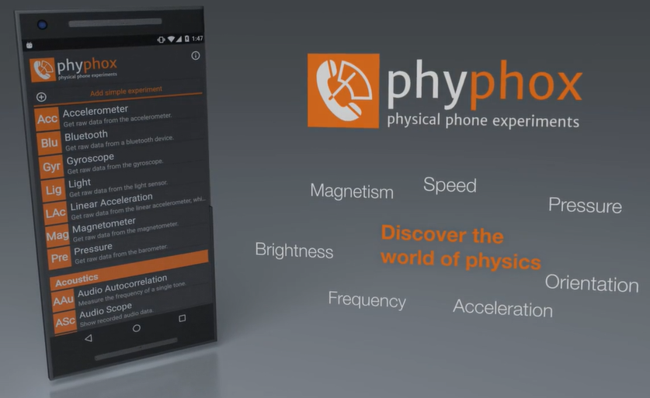
Getting to Know Phyphox
What is Phyphox?
Phyphox (PHYsics PHOne eXperiments) is an app designed at the Univesity of Aachen, Germany, by physicist Sebastian Staacks and his team (Staacks et al., 2019). It utilizes sensors in one’s smartphone or tablet to collect various forms of data, export measurements for analysis, and even design custom experiments.

Slide 4
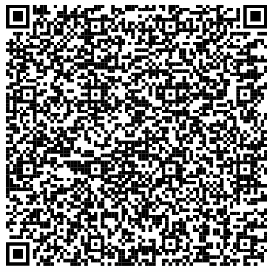
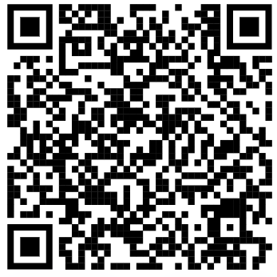
Getting to Know Phyphox
It is available on all Android and Apple operating systems.
It turns learners’ phones into data acquisition tools!

Slide 5
Getting to Know Phyphox
Phyphox also allows for remote access and connection to another device.
Data can also be exported to cvs, xls, or tab-separated value formats.
Notes:
Prior to discussing the various sensors and how to access them on a projector, how to gain remote access can be demonstrated.

Slide 6
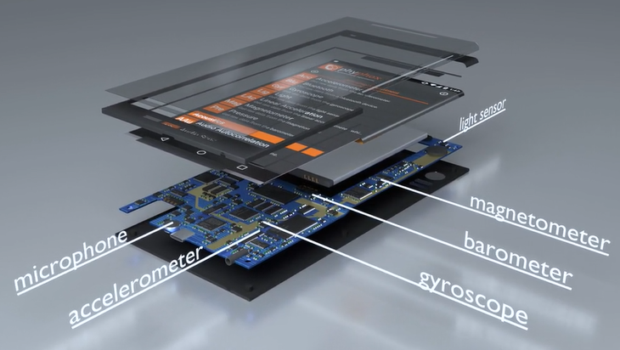
Getting to Know Phyphox
Input sensors
Accelerometer
Magnetometer
Gyroscope
Light sensor
Pressure
Proximity sensor
Microphone
GPS/Location
Bluetooth for custom devices

Slide 7
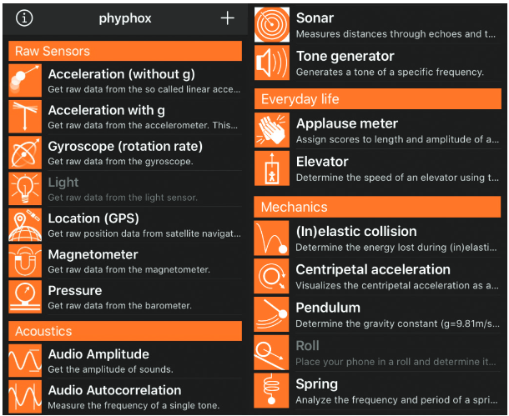
Getting to Know Phyphox
What is Phyphox?
Phyphox’s available bult-in experiments cited upon opening the app. However, phyphox is opon source and the app is not limited to the experiments that are built in. Students and teachers can be creative and inventive; the app is even Arduino compatible (Carroll & Lincoln, 2020, p. 6)
Notes:
A brief overview of the built-in experiments can be provided, followed by mentioning the possibility for tailored experiments or further innovation.

Slide 8
Pedagogy
Inquiry
Utilizing the various sensors in order to question and design investigation allows for different types of guided or open inquiry among learners.
Competency-Development
The use of phyphox fosters development of competencies such as questioning new ideas, planning and conducting experiments, and a host of other competencies inherent in scientific investigation and in the nature of science.
Customizable
Because the applications of the built-in tools are rife with possible applications, the concepts or components of specific content can be tailored by educators and learners to meet their specific needs.

Slide 9
Pedagogy
Detailed Analysis
Because measurements and data can be exported to other formats and other devices, detailed analysis of data is permitted.
Competency-Development
The use of Phyphox fosters development of competencies such as questioning new ideas, planning and conducting experiments, and a host of other competencies inherent in scientific investigation and in the nature of science.
Ongoing support
Phyphox has a community of users which contribute to the online forum to share ideas and continually refine the use of the app.

Slide 10
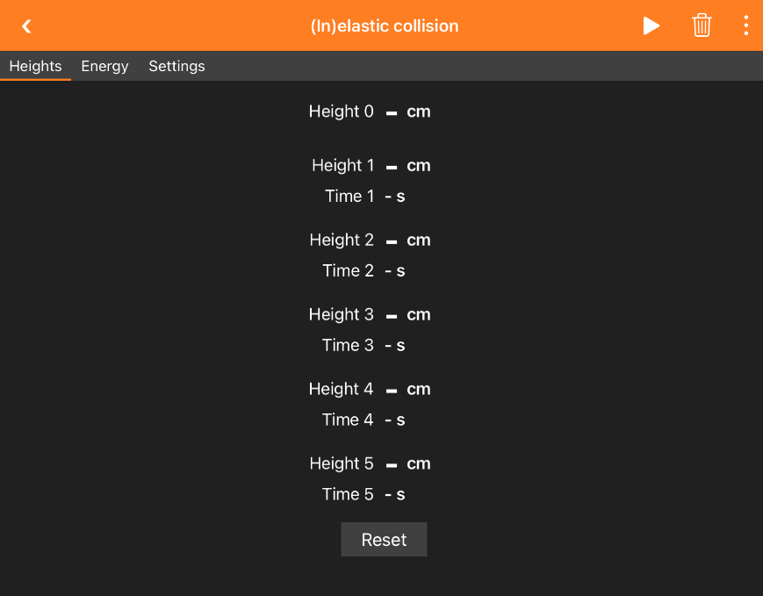
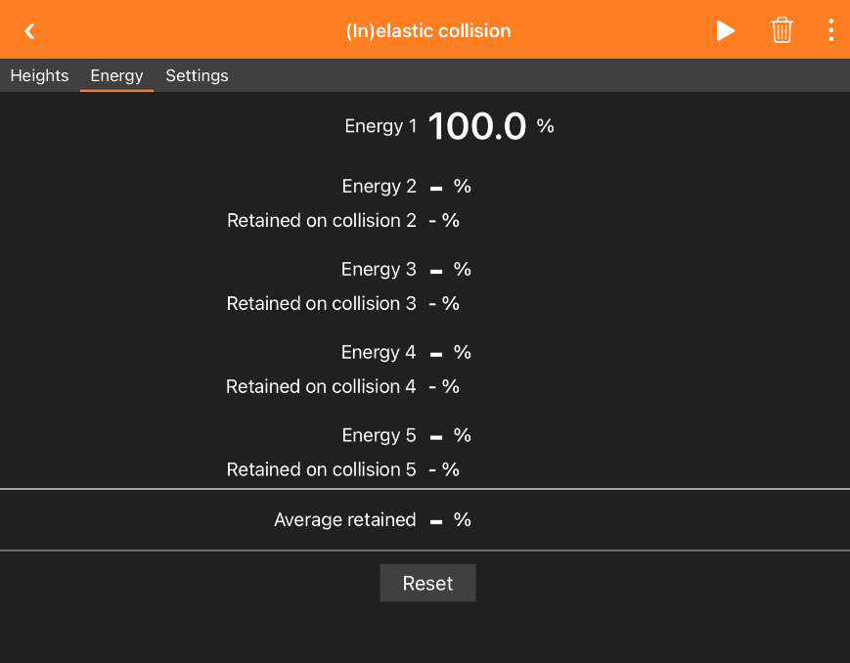
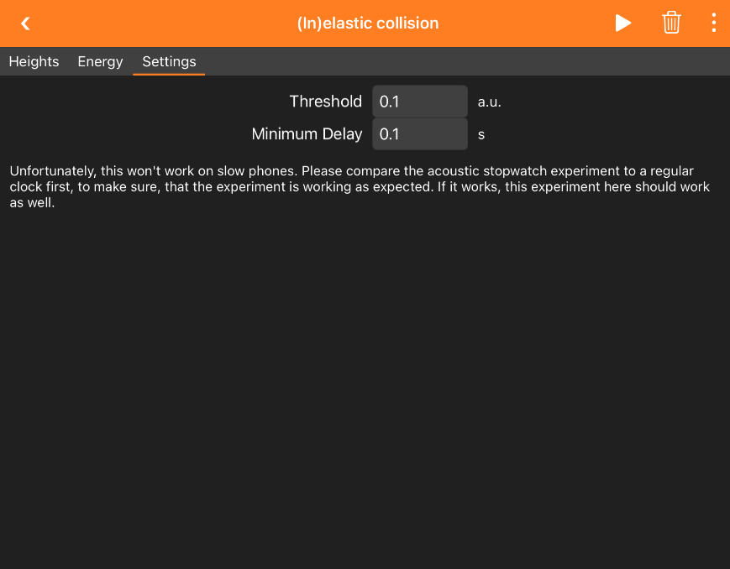
A Sampling of the Endless Possibilities
Conservation of Energy
Among the many possible approaches to exploring this principle, the built-in (In)elastic Collision experiment can be utilized.
Notes:
Provide a description of the various measurements and settings within the (In)elastic Collision experiment.

Slide 11
A Sampling of the Endless Possibilities
Conservation of Energy
(Phyphox, 2020)

Slide 12
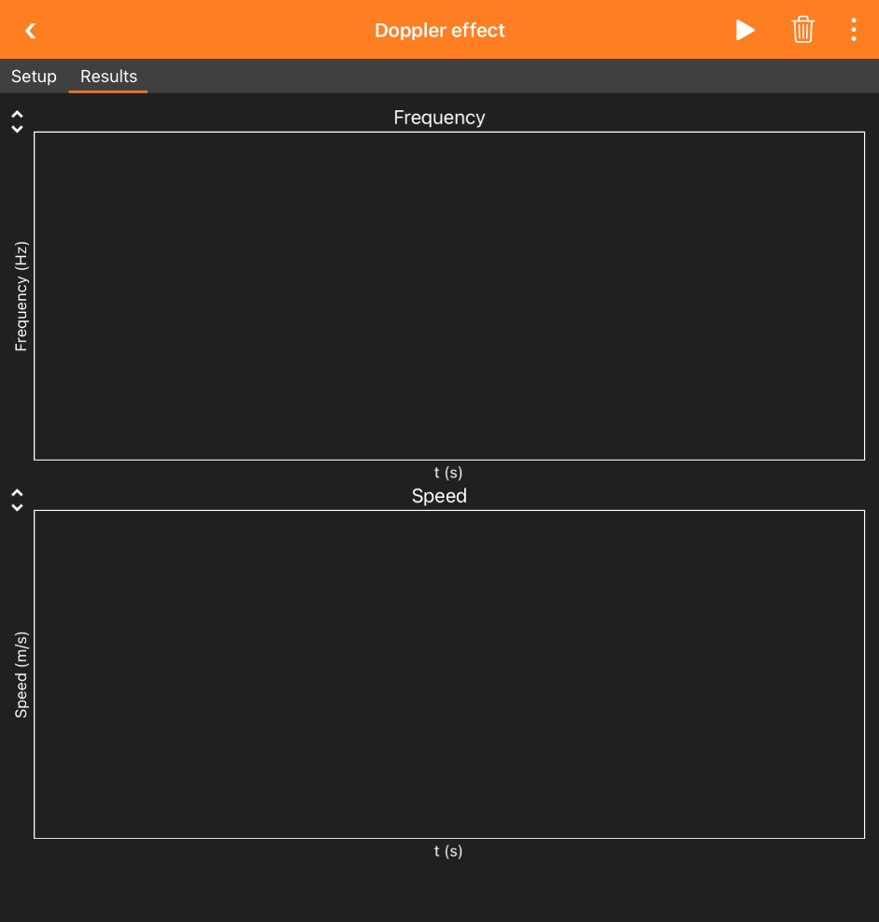
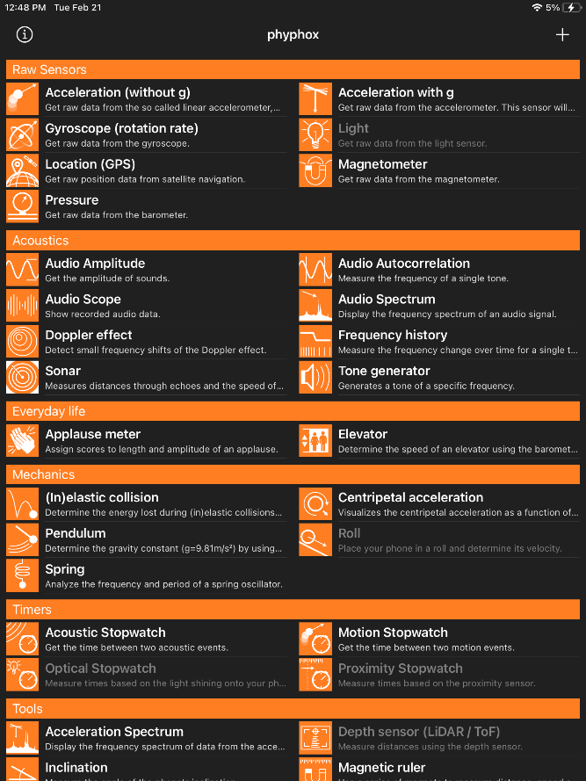
A Sampling of the Endless Possibilities
The Doppler Effect
Another built-in experiment measures the Doppler effect.
Notes:
Provide a description of the various measurements and settings within the Doppler effect experiment.

Slide 13
A Sampling of the Endless Possibilities
The Doppler Effect
The Doppler Effect with Sound - YouTube
(Saturday Morning Astrophysics at Purdue, 2021)

Slide 14
Playtime!
Explore the app!
Try different experiments and data collection tools at your leisure.
Feel free to try the equipment provided by the presenters!
Notes:
Balls, ramps, and other tools can be provided for attendees to utilize as the app is navigated.

Slide 15
Resources and Support
Phyphox PD website – phyphoxpd.weebly.com
Lesson Planning – phyphox.org/experiment/
Phyphox Wiki – https://phyphox.org/wiki
Forums – phyphox.org/forums/
Ambassador program – phyphox.org/contact/
In Canada, the ambassador is Solmaz Khodaeifaal who is based out of Simon Fraser University in Burnaby, British Columbia and who can be contacted via email.
skhodaei@sfu.ca
Additional support – contact@phyphox.org

Slide 16
Resources and Support
Get Connected!
youtube.com/c/PhyphoxOrg
Phyphox
@rwth_phyphox

Slide 17
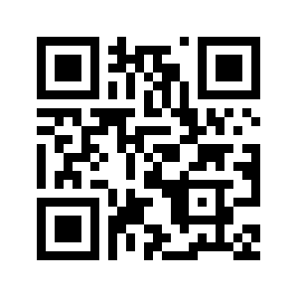
Q & A
If you have any further questions, please consult our website or the phyphox website.
phyphoxpd.weebly.com
phyphox.org

Slide 18
References
Carroll, R., & Lincoln, J. (2020). Phyphox app in the physics classroom. The Physics Teacher, 58(8), 606-607. https://doi.org/10.1119/10.0002393
Phyphox. (2020, March 21). #homelabchallenge: Bouncing Ball (en) [Video]. YouTube. https://www.youtube.com/watch?v=Zm_tAkWmZPo&embeds_euri=https%3A%2F%2Fphyphoxpd.weebly.com%2F&source_ve_path=Mjg2NjY&feature=emb_logo
Saturday Morning Astrophysics at Purdue. (2021, September 27). Doppler Effect with Sound [Video]. YouTube. https://www.youtube.com/watch?time_continue=14&v=2UhX5dugKmg&embeds_euri=https%3A%2F%2Fphyphoxpd.weebly.com%2F&feature=emb_logo
Staacks, S., Hütz, S., Heinke, H., & Stampfer, C. (2018). Advanced tools for smartphone-based experiments: Phyphox. Physics Education, 53(4), 045009. https://doi.org/10.1088/1361-6552/aac05e

